Slide 1
Newton’s Laws

Slide 2
First Law (the law of inertia)
An object at rest stays at rest and an object in motion stays in motion with the same speed and in the same direction unless acted upon by an unbalanced force.
Everything in the universe is lazy; It will continue doing what it is already doing unless a force acts upon it.
Notes:
Examples; Stationary object on desk
Corners in car
Seatbelt, airbags as safety features etc

Slide 3
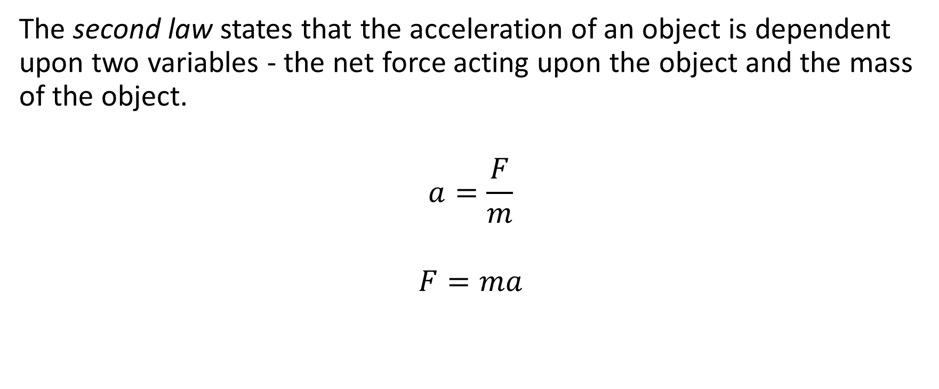
Newton’s second law
The second law states that the acceleration of an object is dependent upon two variables - the net force acting upon the object and the mass of the object.
$$a=\frac{F}{m}$$
$$F=ma$$
Notes:
Example problem

Slide 4
Newton’s Third law
“For every action, there is an equal and opposite reaction.”
Forces act in pairs. If two objects interact with each other, each object applies a force on the other.
If a person pushes on a wall, the wall pushes back. This force is equal in magnitude, but opposite in direction.
Notes:
Finger on desk

Slide 5
Net force
Net force refers to the sum of all forces on an object. We do not add the reaction force specified in law 3 to this calculation; It is a force on another object.
3rd law forces- F(A on B) and F(B on A)
Equal in magnitude
Opposite in direction
Have the same fundamental nature (both a push)
Each acts on a different object
They cannot be added to make a net force.

